Slide 1
Employee Data Analysis using Excel
STUDENT NAME: Charulatha.D.G
REGISTER NO:312209409
DEPARTMENT: B.c om accounting and finance
COLLEGE: ANNA ADARSH COLLEGE FOR WOMEN

Slide 2
PROJECT TITLE
Employee Performance Analysis using Excel

Slide 3


AGENDA
Problem Statement
Project Overview
End Users
Our Solution and Proposition
Dataset Description
Modelling Approach
Results and Discussion
Conclusion
3/21/2024 Annual Review

Slide 4

PROBLEM STATEMENT
The company has a diverse workforce, and performance evaluations are critical for making informed decisions about promotions, rewards, and professional development. The data available includes performance metrics, employee details, and historical performance reviews.

Slide 5

PROJECT OVERVIEW
.
Data analytics refers to the process of examining, cleaning, transforming, and modeling data
with the goal of discovering useful information, drawing conclusions, and supporting decisionmaking.
It involves the use of various techniques, tools, and algorithms to analyze raw data and extract
patterns, trends, correlations, and other insights that can inform business strategies, improve
operational efficiency, and drive innovation.
In essence, data analytics turns raw data into actionable insights, empowering organizations to
make smarter, faster, and more strategic decisions.

Slide 6

WHO ARE THE END USERS?
Managers and team leaders
Human resources
It and data analytics
Financial department
Compliance and legal team

Slide 7

OUR SOLUTION AND ITS VALUE PROPOSITION
CONDITIONAL FORMATING: MISSING VALUES
FILTERING: REMOVE BLANK CELLS
PIVOT TABLE: SUMMY OF EMPLOYEE DATA ANALYSIS
GRAPH: VISUALIZATION OF EMPLOYEE DATA ANALYSIS

Slide 8
Dataset Description
Descriptions for each of the columns in the dataset:
1.Employee ID: Unique identifier for each employee in the organization.
2.First Name: The first name of the employee.
3.Last Name: The last name of the employee.
4.Start Date: The date when the employee started working for the organization.
5.Exit Date: The date when the employee left or exited the organization (if applicable).
6.Title: The job title or position of the employee within the organization.
7.Supervisor: The name of the employee's immediate supervisor or manager.
8.Email: The email address associated with the employee's communication within the
organization.
9.Business Unit: The specific business unit or department to which the employee belongs.
10.Employee Status: The current employment status of the employee (e.g., Active, On Leave,
Terminated).
11.Employee Type: The type of employment the employee has (e.g., Full-time, Part-time,
Contract).
12.Pay Zone: The pay zone or salary band to which the employee's compensation falls.
associated with.

Slide 9

THE "WOW" IN OUR SOLUTION
1.Interactive Data Filtering:
Real time filtering
2. Multiple Slicers for Comparative Analysis:
Side by side comparison
3.Accessibility and Ease of Use:
User friendly reaction
3/21/2024 Annual Review
9

Slide 10
MODELLING
Data Collection:
The Data Collection Was Download In “Kaggle”.
Feature Collection
In This Data Base It Has 26 Features I Had Use 4 Featurs
Of My Projects.
Data Cleaning:
In This Step I Had Identify The Missing Value And
Remove The Blank.
Summary:
For My Project I Used Pivot Tables For Employee Data
Analysis And Also Used Sclicer Tool For Classify
Employees On Basis Of Contract, Full Time, Part Time.
Visualization:
For My Project I Had Use To Visulized My Employee Data
10

Slide 11
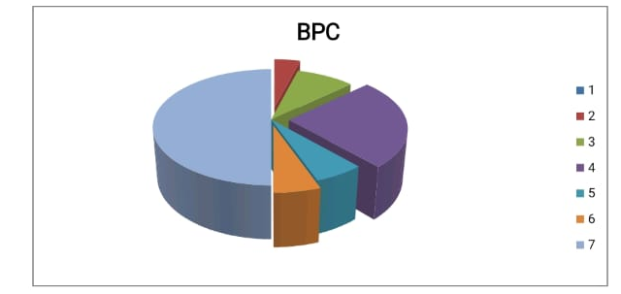
RESULTS
11

Slide 12
conclusion
This project has successfully analyzed employee data

